Slide 1
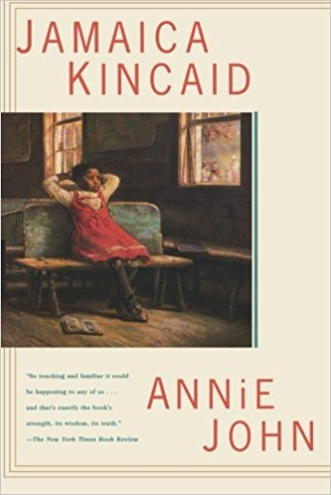
Annie John (1985)
Jamaica Kincaid’s first novel is a work of autobiographical fiction. The chapters were originally published separately in The New Yorker.
Annie John is a Bildungsroman* that explores:
colonialism and the colonial legacy in postcolonial society
gender and sexuality
mother-daughter relationships
colonial education – especially reading and writing history and literature
adolescence / coming of age
*Bildungsroman is German for “formation novel.” It is a literary genre that focuses on the development of the protagonist from youth to adulthood. A “coming-of-age” novel.

Slide 2
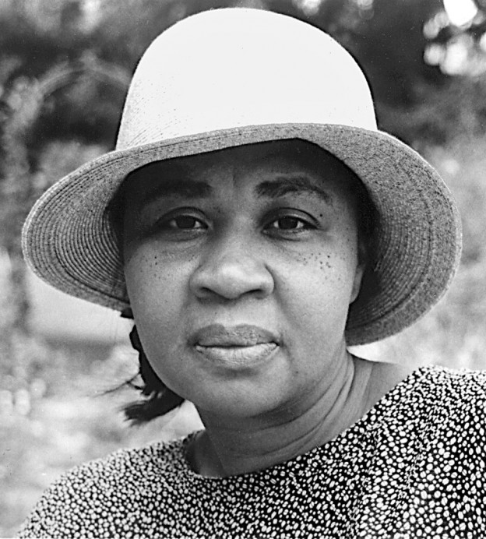
Jamaica Kincaid, an Antiguan-American novelist and essayist, was born Elaine Potter Richardson in 1949 in St John, Antigua. Annie John draws on her own experiences of growing up in poverty on the island and being educated in the British colonial system. At the age of 17 her mother sent her to New York City to work as a nanny. Kincaid enrolled in evening classes at a community college, and after three years she quit her nanny job to attend Franconia College in New Hampshire on a scholarship. Kincaid dropped out of Franconia after one year and returned to New York to write for magazines.

Slide 3
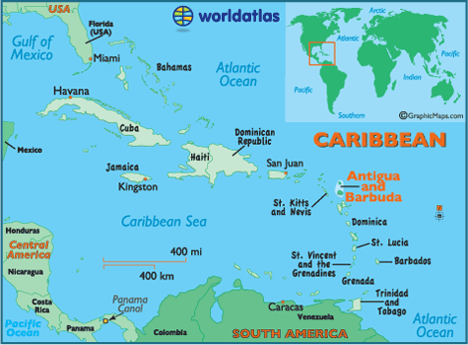
Antigua is one of the two major islands that make up the Caribbean nation of Antigua and Barbuda.
Antigua was “discovered” by Christopher Columbus in 1493 and was colonized by the British in 1632. After the annihilation of the native population, the British used tens of thousands African slaves to turn Antigua (and many other Caribbean islands) into a highly profitable sugar plantation. Antigua gained formal independence from England in 1981

Slide 4


Slide 5




Slide 6
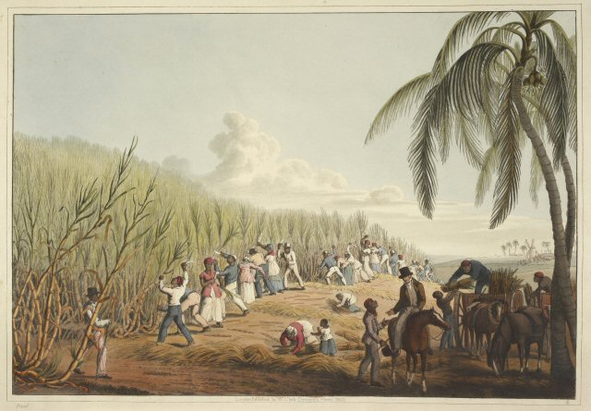

Slide 7
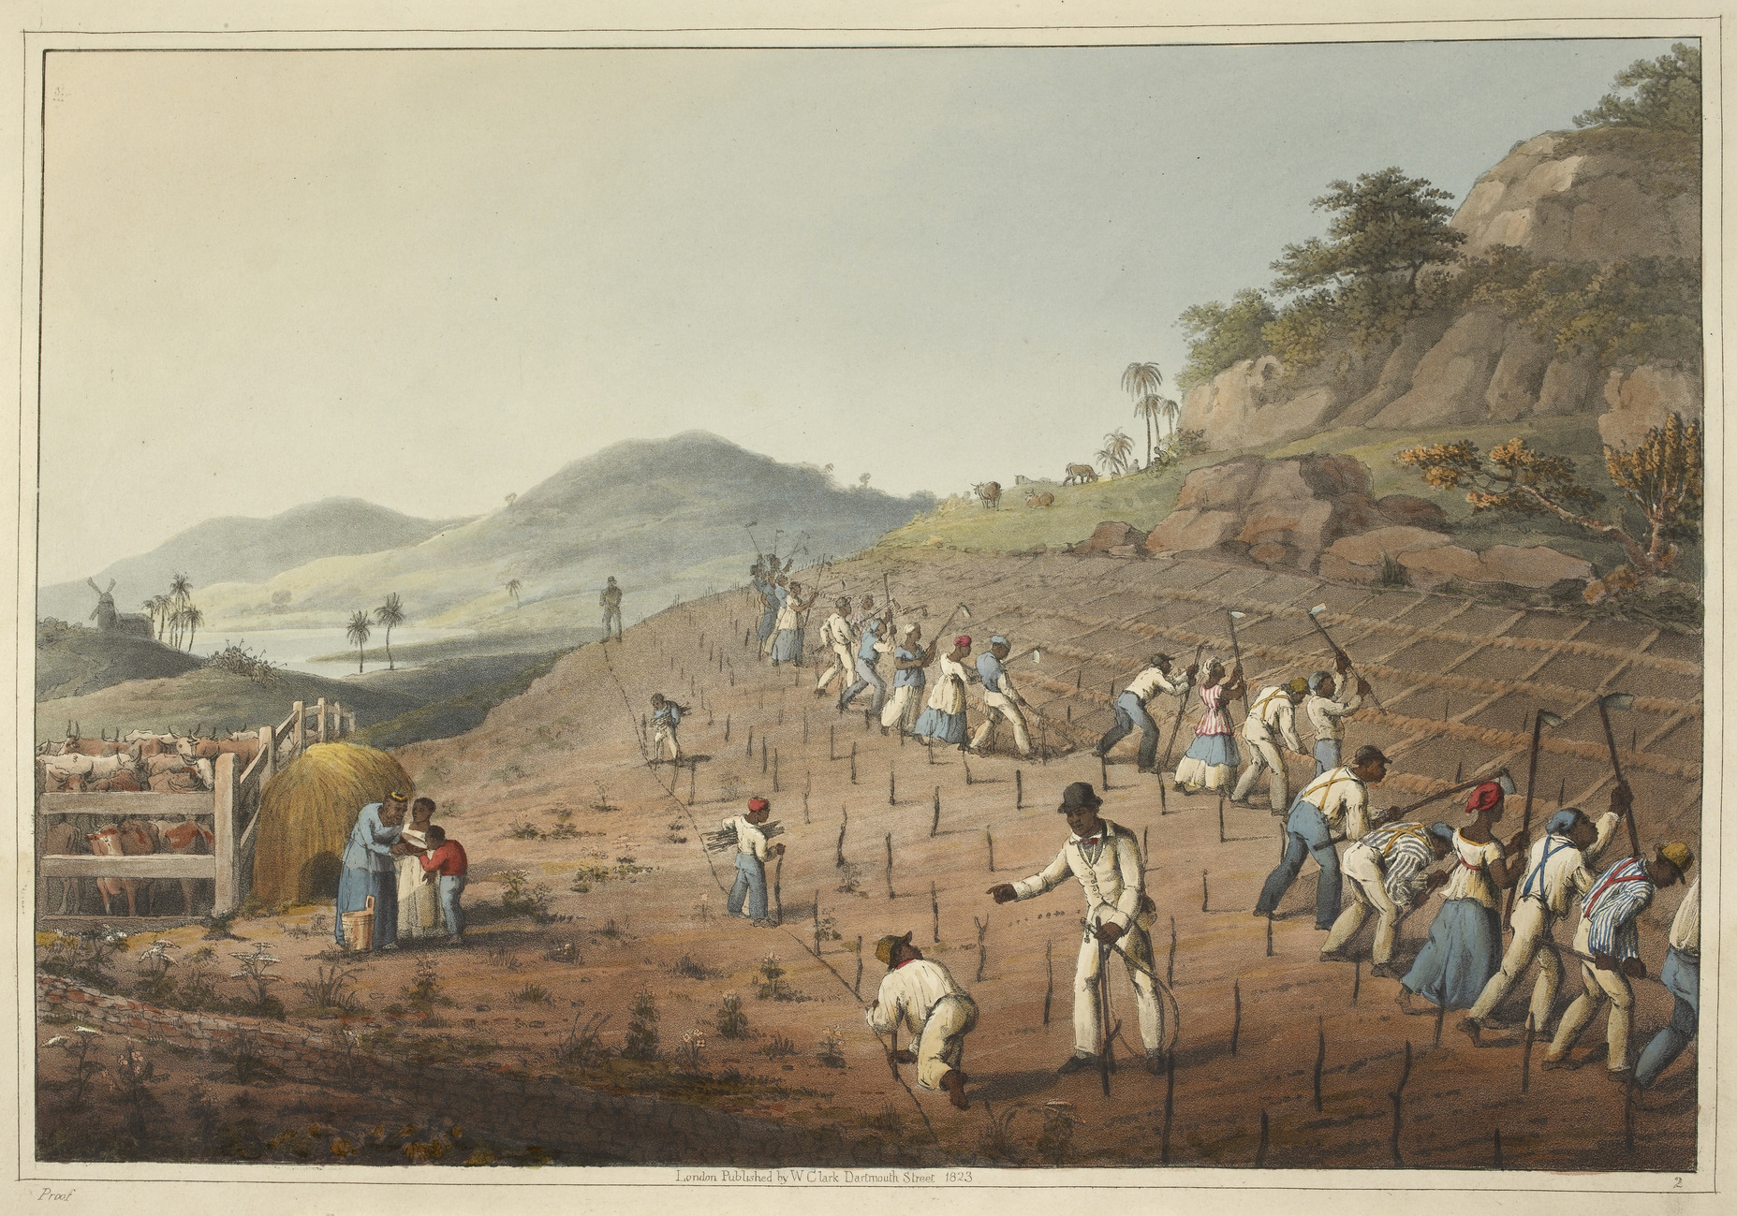

Slide 8
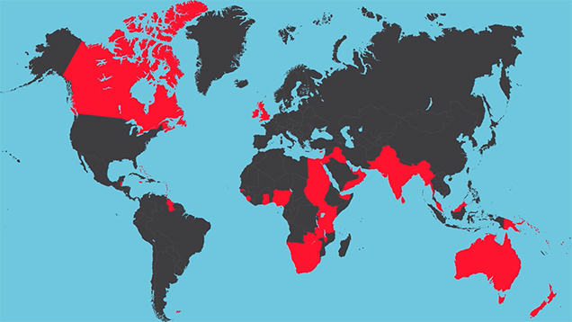
Map of British Empire, 1920

Slide 9
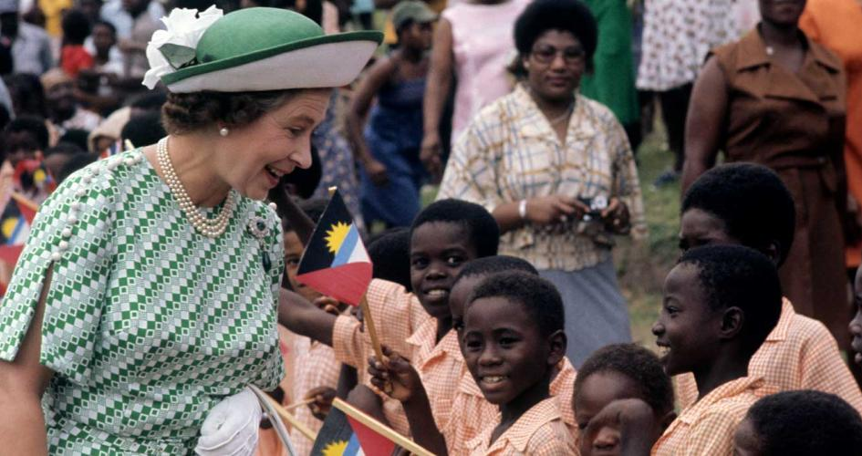
Antigua and Barbuda is an independent nation within the British Commonwealth, but the Queen of England is still the “Constitutional Monarch” of the islands. In all of her official duties in relation to the islands she speaks and acts as Queen of Antigua and Barbuda. The Queen is not involved in the day-to-day business of the Antigua and Barbuda Government, but she continues to play important ceremonial and symbolic roles.

Slide 10
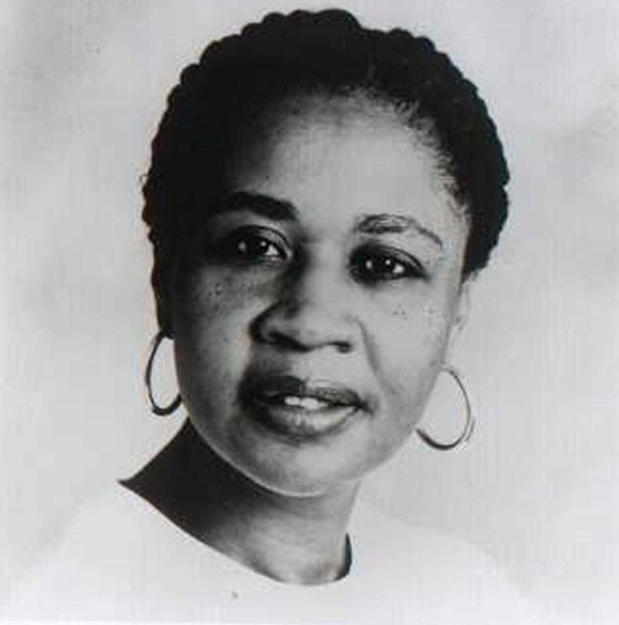
“I’m someone who writes to save her life, I mean, I can't imagine what I would do if I didn't write. I would be dead or I would be in jail because -- what else could I do? I can't really do anything but write. All the things that were available to someone in my position involved being a subject person. And I'm very bad at being a subject person” (Kincaid 1990).
^{Interview}

Slide 11
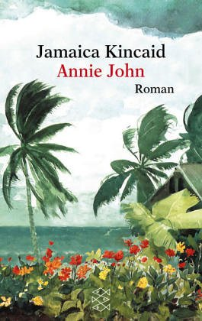
Style and Form
Kincaid's writing is not in the traditional paragraph form, but uses run-on sentences and paragraphs with fragments.
Caribbean poet Derek Walcott described Kincaid's writing in the following way:
"As she writes a sentence, psychologically, its temperature is that it heads toward its own contradiction. It's as if the sentence is discovering itself, discovering how it feels. And that is astonishing, because it's one thing to be able to write a good declarative sentence; it's another thing to catch the temperature of the narrator, the narrator's feeling. And that's universal, and not provincial in any way.”

